Slide 1
Introduction to R

Slide 2
Goals for Today
Downloading R and R Studio
R Overview
Installing packages
Getting Started with Swirl
Preview Next Week
2
Notes:
2

Slide 3
Downloading R and R Studio

Slide 4
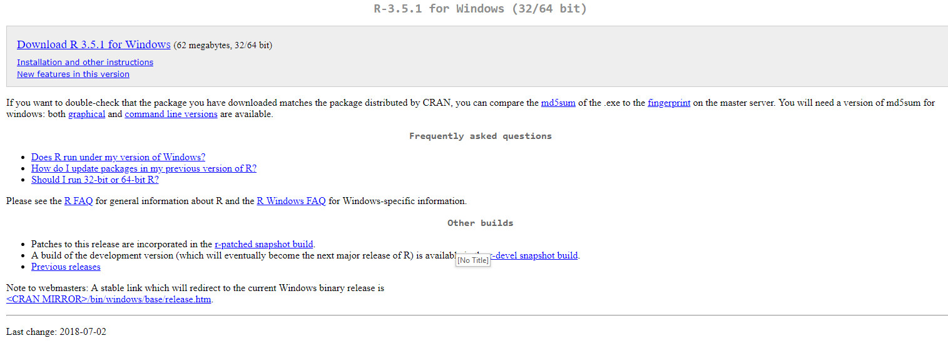
Downloading and Installing R
Navigate to https://www.r-project.org/ and click on “CRAN” underneath the “Download” section of the sidebar. Select the mirror of your choice (the closest is probably https://ftp.ussg.iu.edu/CRAN/) and download the appropriate version of R for your Operating System. If asked, download the “base” subdirectory.
You should be able to accept all the default values in the installer.
4
Notes:
4

Slide 5
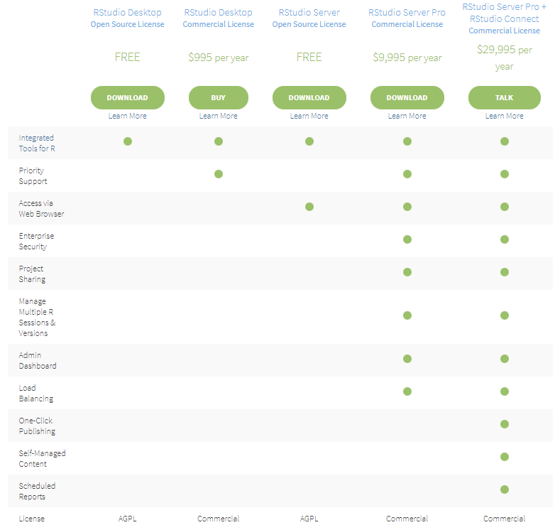
Downloading and Installing R Studio
Navigate to https://www.rstudio.com/products/rstudio/download/ and download “R Studio Desktop” for your operating system. Again, you can use the default installation options.
5
Notes:
5

Slide 6

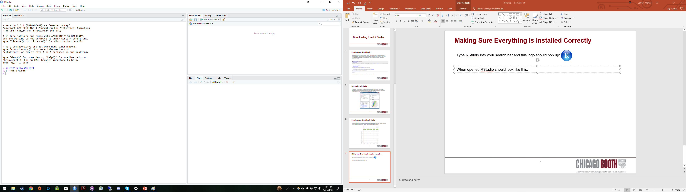

Making Sure Everything is Installed Correctly
Type RStudio into your search bar and this logo should pop up:
Open R studio and try typing in print(“Hello World!”) to make sure everything is working as intended:
Feel free to also trying asking R to perform some basic calculations!
6
Notes:
6

Slide 7
What is R?

Slide 8
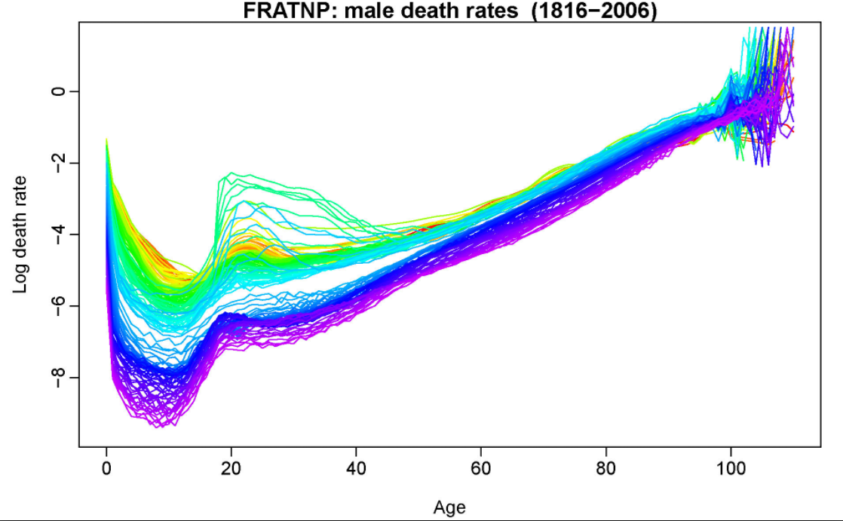
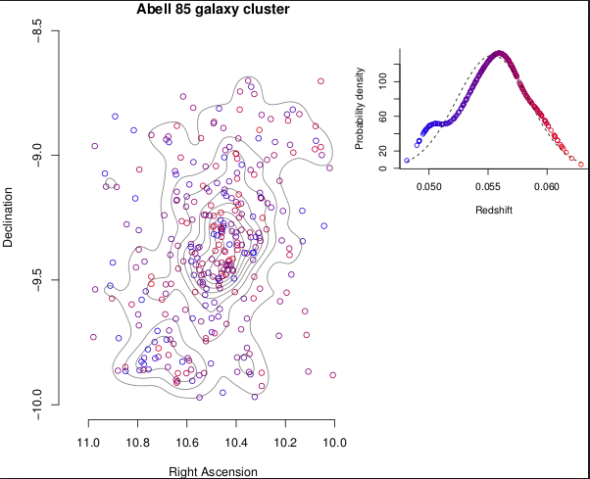
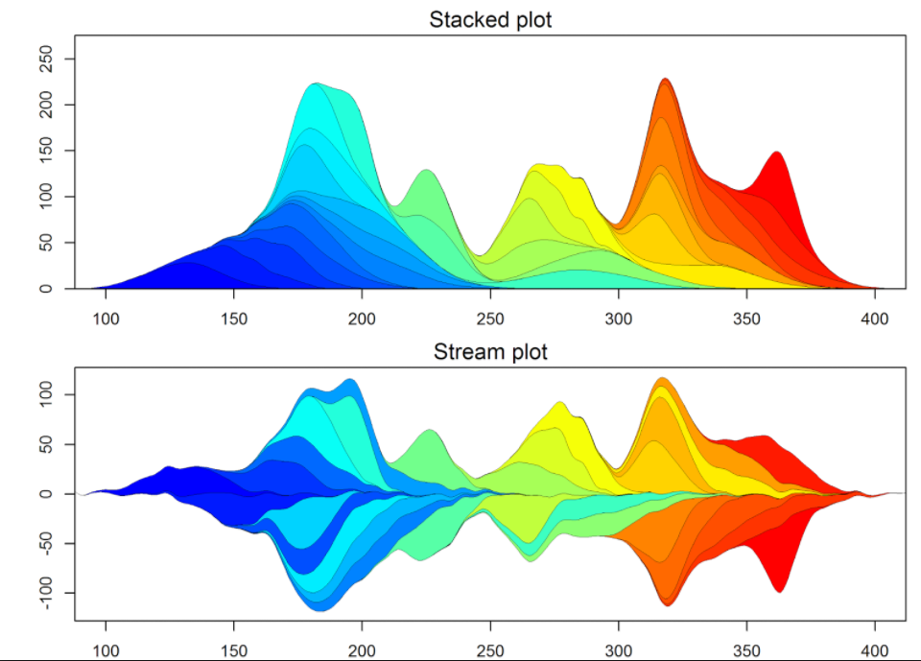
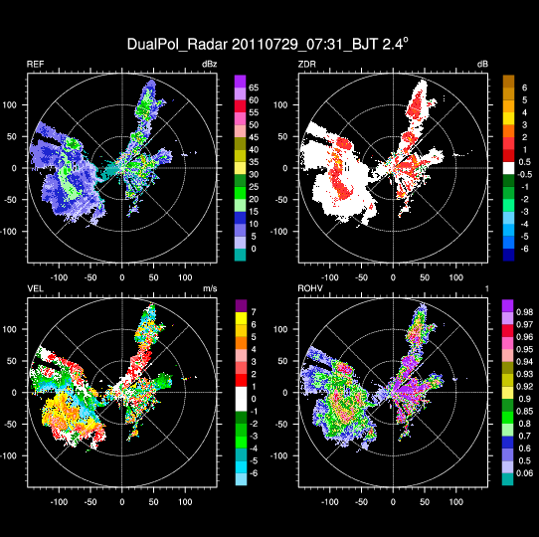
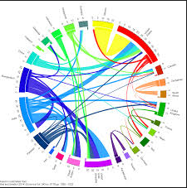
What is R?
R is an open source (thus FREE) programming language for statistical computing and plotting that is supported by the R Foundation for Statistical Computing. R is widely used among academics, statisticians, and data scientists for data analysis and is the default statistical programming language here at Booth.
R’s primary strength is its support of user-written packages that allow you to easily run complicated/state of the art analyses without having to write (or necessarily even understand) the code yourself. In particular, R’s visualization packages are considered best-in-class.
8
Notes:
8

Slide 9
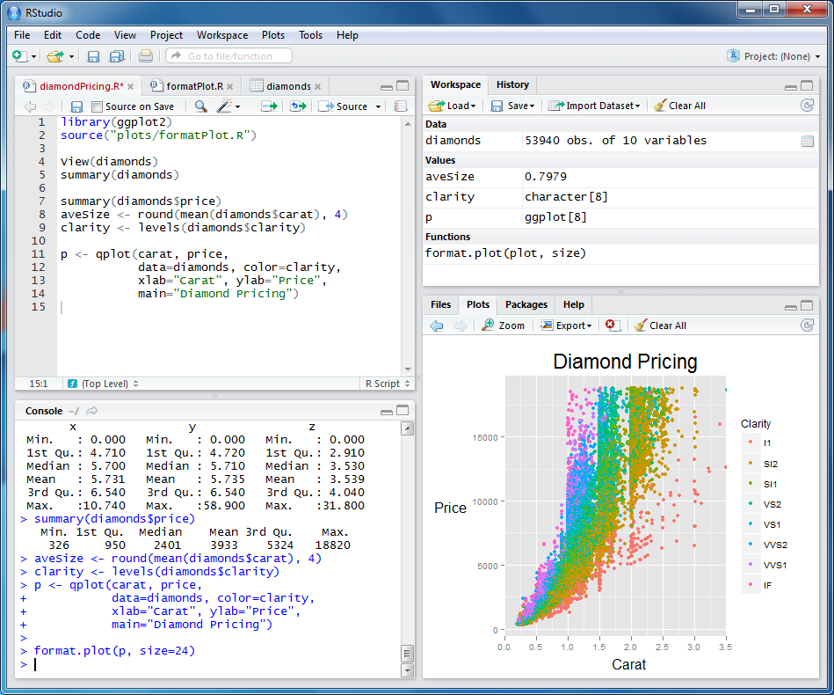
What is R Studio?
R Studio is a FREE integrated development environment (IDE) for R and the preferred IDE at Booth. It provides a convenient interface to write and test code, see your working directory, and examine plots/read help files all at the same time.
9
Notes:
9

Slide 10
Installing Packages

Slide 11
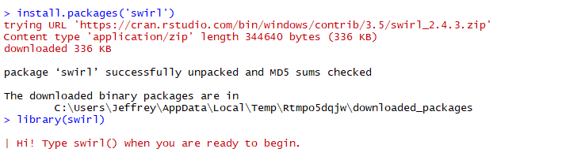
Installing and Loading Packages in R
One of the key strengths of R is the fact that so many R developers have written packages and shared them with the larger community through CRAN (the Comprehensive R Archive Network). Base R allows you to install and load these packages directly through the R interface with the install.packages() and library() functions. The package that we are going to install and use today is “swirl”, a software package for learning R, directly in R!
Type ‘install.packages(“swirl”)’ followed by ‘library(swirl)’.
This is exactly the same process you will use to install and load any R packages that you may need in the future
11
Notes:
11

Slide 12
Getting Started with Swirl

Slide 13
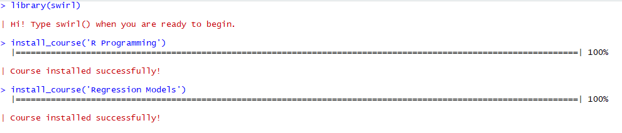
Swirl Courses to Install
Swirl courses can be installed with the following function (which we downloaded when installing the swirl package): install_course().
Let’s install the “R Programming” and “Regression Models” courses by typing install_course(“R Programming”) and install_course(“Regression Models”)
13
Notes:
13

Slide 14
Swirl Lessons to Try
After using the swirl() function to open swirl, it will list the courses you have installed. After selecting a course, it will then list lessons for you to select. For purposes of getting started with R, I recommend you start with the following courses:
R Programming:
1. Basic Building Blocks
3. Sequences of Numbers
4. Vectors
6. Subsetting Vectors
7. Matrices and Data Frames
14
Notes:
14

Slide 15
R Programming

Slide 16
Basic Building Blocks
16
Notes:
16

Slide 17
Wrap Up

Slide 18
More Resources
https://swirlstats.com/
https://www.datacamp.com/
http://tryr.codeschool.com/
Or just ask! jmejiare@chicagobooth.edu or jmckee0@chicagobooth.edu
18
Notes:
18

Slide 19
Preview of Next Week’s Session
https://swirlstats.com/
https://www.datacamp.com/
http://tryr.codeschool.com/
Or just ask! jmckee0@chicagobooth.edu or @jmckee on Slack
19
Notes:
19

